Slide 1
Shell Bootcamp 2024 3 Reflections for Week #<>
Avni Tonger
Date : 30-Aug-2024

Slide 2
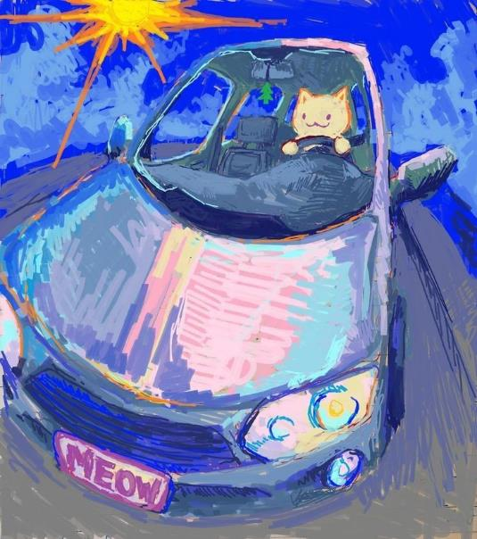
About Me
Love is the only thing that matters at all
Love for others, love for self, love for life
Everything else is just a distraction

Slide 3

My learnings from this week!

Slide 4
Learning 1 | My takeaways
Email writing is essential for clear and professional communication. It involves structuring messages effectively and using the right tone.
Key learning: The key learning is the importance of clarity and brevity in emails to ensure the message is understood.
Key takeaway: Well-written emails enhance communication efficiency and professionalism.
In the Energy sector, clear emails help coordinate projects and share critical updates efficiently
[Add a graphic that provides evidence of what you learned]

Slide 5
Learning 2 | My takeaways
Stakeholder management involves identifying and engaging with individuals or groups who have an interest in a project or organization. Effective stakeholder management ensures their needs and expectations are met.
Key learning: The importance of clear communication and building strong relationships with stakeholders to ensure project success.
Key takeaway: Engaging stakeholders effectively can lead to better project outcomes and increased support.
In the Energy sector, managing stakeholders is crucial for gaining approvals, ensuring compliance, and fostering collaboration on projects.
[Add a graphic that provides evidence of what you learned]

Slide 6
Learning 3 | Trust and Integrity
Trust and integrity are fundamental principles that guide ethical behavior and foster reliable relationships. They involve being honest, transparent, and consistent in actions and decisions.
The key learning is that maintaining trust and integrity builds credibility and strengthens relationships, both personally and professionally.
Upholding trust and integrity leads to a positive reputation and long-term success.
In the Energy sector, trust and integrity are crucial for ensuring safety, compliance, and fostering collaboration among stakeholders.
[Add a graphic that provides evidence of what you learned]

Slide 7

Relevance of learnings for my organization

Slide 8
Learning 1 | Relevance for Shell
How I feel Shell implements this learning (in your own words)
How I feel Shell benefits from this learning (in your own words)
[Add a graphic that provides view of how Shell implements this learning]

Slide 9
Learning 2 | Relevance for Shell
How I feel Shell implements this learning (in your own words)
How I feel Shell benefits from this learning (in your own words)
[Add a graphic that provides view of how Shell implements this learning]

Slide 10
Learning 3 | Relevance for Shell
How I feel Shell implements this learning (in your own words)
How I feel Shell benefits from this learning (in your own words)
[Add a graphic that provides view of how Shell implements this learning]

Slide 11

Challenges in implementing learning

Slide 12
Challenge faced while implementing Learning 1
What were the challenges I faced while implementing Learning 1 and my plan to overcome them
GitHub link of your solution/documentation
[Add a graphic that provides evidence of what you did to overcome this challenge]

Slide 13
Challenge faced while implementing Learning 2
What were the challenges I faced while implementing Learning 2 and my plan to overcome them
GitHub link of your solution/documentation
[Add a graphic that provides evidence of what you did to overcome this challenge]

Slide 14
Challenge faced while implementing Learning 3
What were the challenges I faced while implementing Learning 3 and my plan to overcome them
GitHub link of your solution/documentation
[Add a graphic that provides evidence of what you did to overcome this challenge]

Slide 15

Action Plan

Slide 16
My Action Plan for this Week
Actions
Timeline
Status
Details of actions planned for the new lrearning or overcoming the challenge
The planned timeline to implement the actions
Status of the same by the end of the week

Slide 17

Learning is also Fun!

Slide 18
Learning is also Fun!
Please share how ”Your” learning was fun this week
Details of any group activity
Details of any funny incident which had an element of new learning for this week’s topic
[Add a graphic or a picture of how you/your team enjoyed the new learning]

Slide 19

Summary
Quick summary
Importance of topics of upcoming week
Connectivity of topics from current week

Slide 20
Thank You

